Slide 1
Churn Prediction Using Machine Learning
Soumyadip Ghatak
A21032

Slide 2
What does Churn mean in business?
Churn means customers or users who left the services or migrates to the competitor in the industry. It is very important for any organization to keep its existing customer and attract new ones if one of them fails it is bad for business. The goal is to explore the possibility of machine learning for churn prediction to retain a competitive edge in the industry.

Slide 3
Why it is important to solve the problem?
In highly competitive markets, like gaming, hotel, subscription apps and casino chains operate in, being able to truly understand our customers is crucial to remaining competitive. To do this, we have to analyze the behavior of our customers and understand what are the attributes of people who may churn.

Slide 4
Project Overview
In this Project we will analyse and build a churn model for a “company” called Sparkify. This company provides music streaming services to customers just like Spotify or Pandora.
To utilize the Spark, we need to set up a spark session in the beginning. We can also do this without actually having a server by using the local cluster.

Slide 5
About our dataset.
There are two datasets that are available: a full dataset of 12GB, that requires the deployment of a cluster to parallelize computation, and a mini-dataset of 128MB. In this repository the focus is on the mini-dataset for now. But due to the nature of this data, we wrote all the code using the Spark Framework to allow easy refactoring on the code to have it run with clusters on a much larger dataset.

Slide 6
Step by step approach.
Data Understanding Included finding missing or random values, understanding the structure of the dataset, understanding column datatypes, finding useful features.
Visualization Everything that can be learned from visualization. This will help to visually understand which features are more suitable for solving the problem.

Slide 7
3. Feature Engineering At this step, we will select features based on the previous steps and combine them into one data frame.
4.Modeling We will use four machine learning algorithms: Logistic Regression, Random Forest, Decision tree. Then we’ll compare them based on metrics: Accuracy and F1.
5.Model Evaluation and Validation At this step, we provide some discussion about the final parameters of the model.

Slide 8
For this project, we have to classify customers who have churned. Not only we will classify these customers but we will build a model that would make predictions.
The approach taken to this problem was to firstly define what churn is. This was defined by using the event of 'Cancellation Confirmation'. If the user cancelled their service, they were defined as churn.
After defining churn, some features were extracted such as gender and level. These features were used and a model was trained and it was used to make predictions.

Slide 9
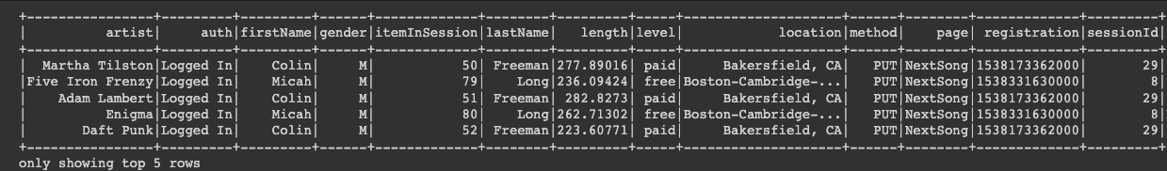
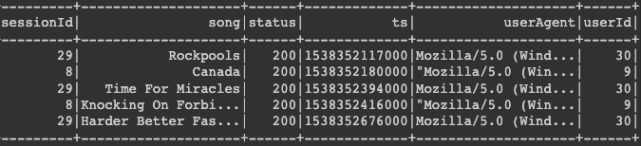
Snapshot of our dataset.

Slide 10
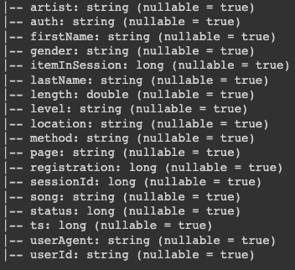
The variables in our dataset.

Slide 11

There were 1101 missing userId records in this dataset. For this, we removed the rows where these were missing.

Slide 12
We filter our dataset and extract the features that we will use.
Based on intuition and domain knowledge, we decide not to include the columns for lastName, method, and userAgent in our first-pass modeling for now, since these variables probably do not affect our prediction. We also decide not to include artist, location, song, and status for now. This leaves us with the following columns

Slide 13
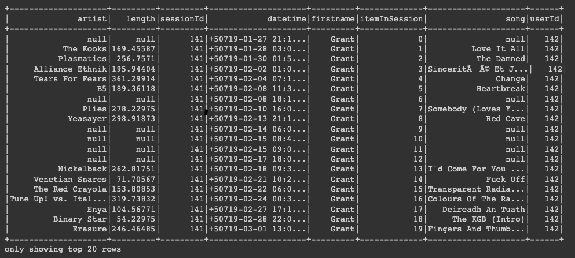

Slide 14
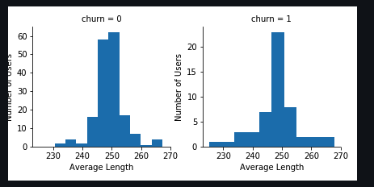
Some important visualization to derive insights.

Slide 15
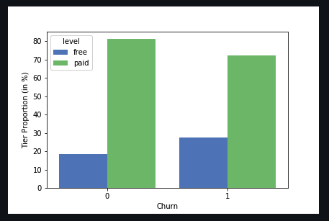

Slide 16
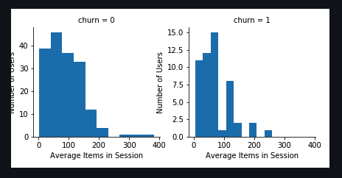

Slide 17
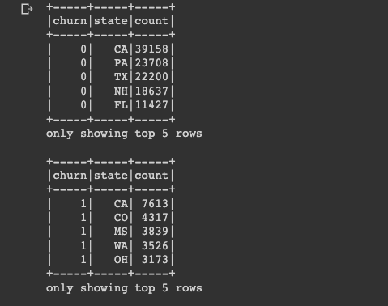
The most present states for people who churned.

Slide 18
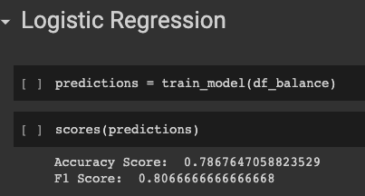
ML Models used:

Slide 19
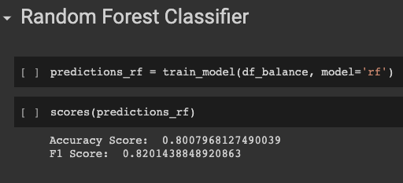

Slide 20
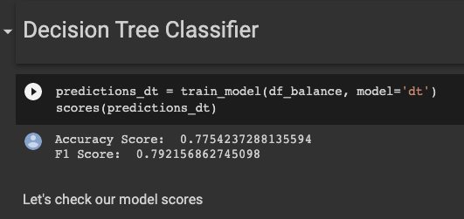

Slide 21
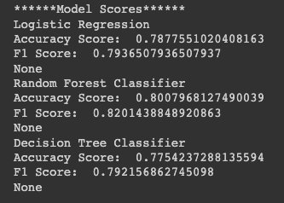

Slide 22
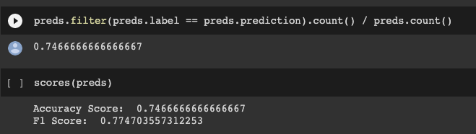
We tried to improve our logistic regression model but it wasn’t. This can be solved by extracting more features.

Slide 23
Thank you.

